Slide 1
BUS 297D: Data Mining
Professor David Mease
Lecture 3
Agenda:
1) Reminder about HW #1 (Due Thurs 9/10)
2) Finish lecture over Chapter 3

Slide 2
Homework 1
Homework 1 is at
http://www.cob.sjsu.edu/mease_d/bus297D/homework1.html
It is due Thursday, September 10 during class
It is work 70 points
It must be printed out using a computer and turned in during the class meeting time. Anything handwritten on the homework will not be counted. Late homeworks will not be accepted.

Slide 3
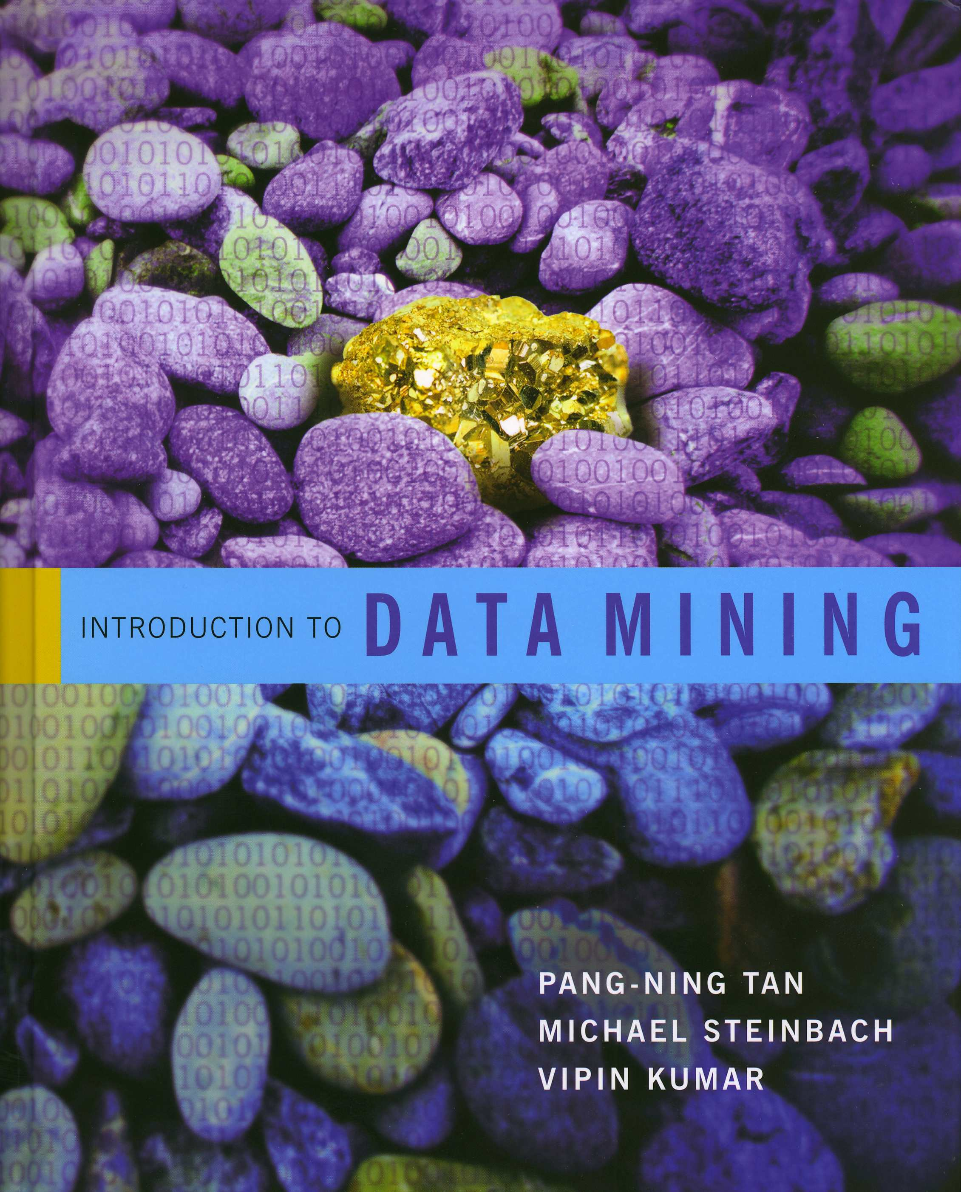
Introduction to Data Mining
by
Tan, Steinbach, Kumar
Chapter 3: Exploring Data

Slide 4
Exploring Data
We can explore data visually (using tables or graphs) or numerically (using summary statistics)
Section 3.2 deals with summary statistics
Section 3.3 deals with visualization
We will begin with visualization
Note that many of the techniques you use to explore data are also useful for presenting data

Slide 5
Boxplots (Pages 114-115)
Invented by J. Tukey
A simple summary of the distribution of the data
Boxplots are useful for comparing distributions of multiple attributes or the same attribute for different groups
outlier
90th percentile
75th percentile
50th percentile
25th percentile
10th percentile

Slide 6
Boxplots in R
The function boxplot() in R plots boxplots
By default, boxplot() in R plots the maximum and the minimum (if they are not outliers) instead of the 10th and 90th percentiles as the book describes
outlier
90th percentile
Maximum
75th percentile
50th percentile
25th percentile
10th percentile
Minimum

Slide 7
Boxplots (Pages 114-115)
Boxplots help you visualize the differences in the medians relative to the variation
Example: The median value of Attribute A was 2.0 for men and 4.1 for women. Is this a “big” difference?

Slide 8
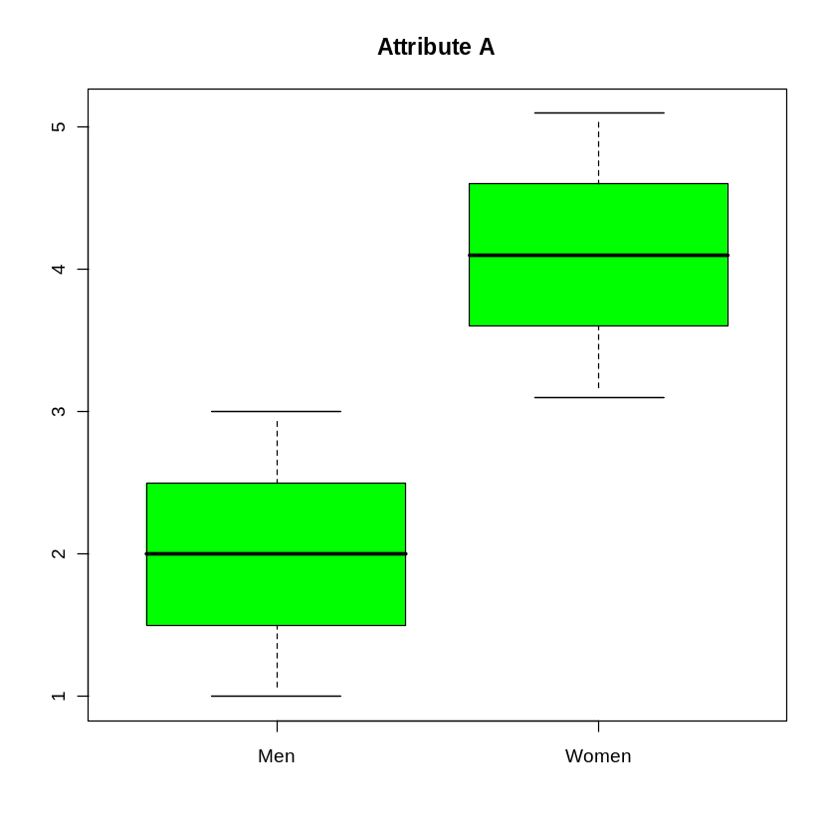
Boxplots (Pages 114-115)
Boxplots help you visualize the differences in the medians relative to the variation
Example: The median value of Attribute A was 2.0 for men and 4.1 for women. Is this a “big” difference?
Maybe yes:

Slide 9
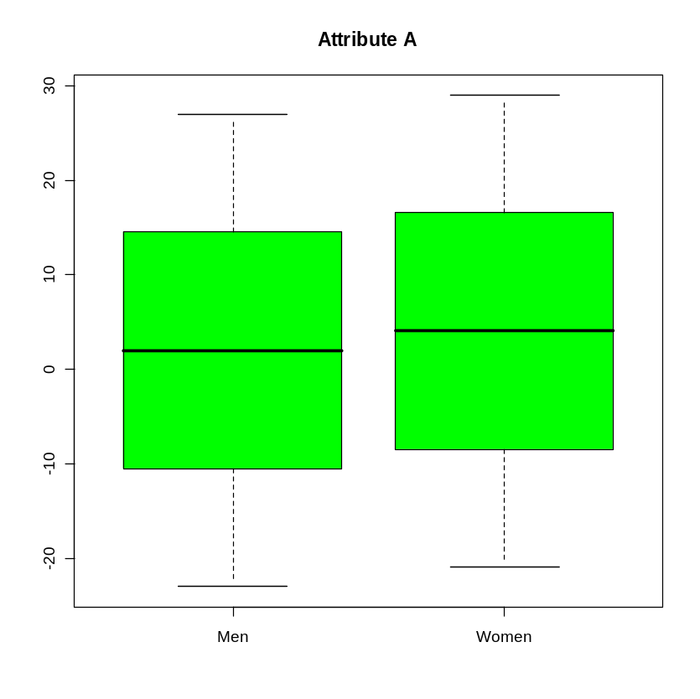
Boxplots (Pages 114-115)
Boxplots help you visualize the differences in the medians relative to the variation
Example: The median value of Attribute A was 2.0 for men and 4.1 for women. Is this a “big” difference?
Maybe yes: Maybe no:

Slide 10
In class exercise #16:
Use boxplot() in R to make boxplots comparing the first and second exam scores in the data at
www.stats202.com/exams_and_names.csv

Slide 11
In class exercise #16:
Use boxplot() in R to make boxplots comparing the first and second exam scores in the data at
www.stats202.com/exams_and_names.csv
Answer:
data<-read.csv("exams_and_names.csv")
boxplot(data[,2],data[,3],col="blue",
main="Exam Scores",
names=c("Exam 1","Exam 2"),ylab="Exam Score")

Slide 12
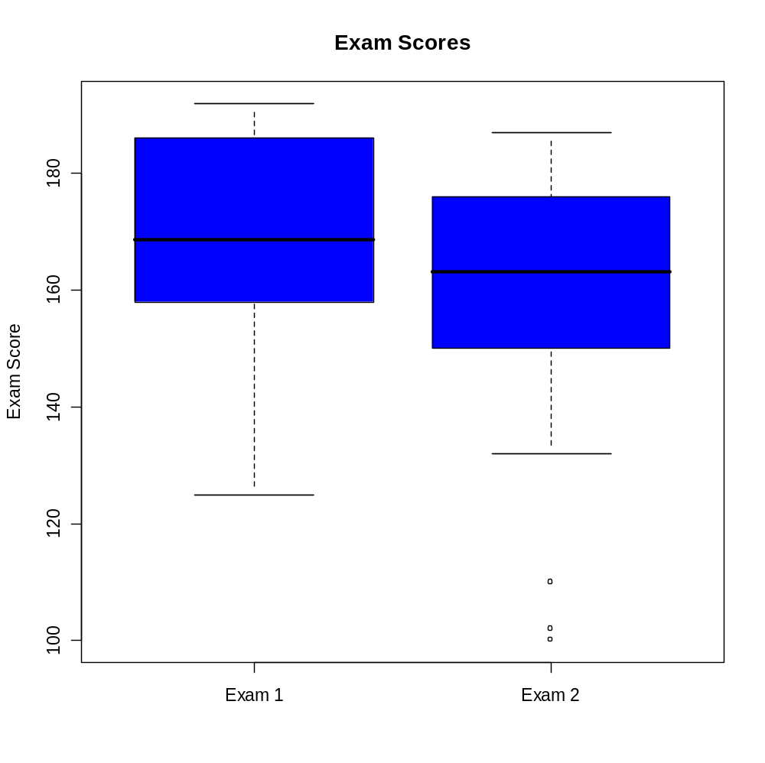
In class exercise #16:
Use boxplot() in R to make boxplots comparing the first and second exam scores in the data at
www.stats202.com/exams_and_names.csv
Answer:

Slide 13
Visualization in Excel
Up until now, we have done all the visualization in R
Excel also can make many different types of graphs. They are found under the “Insert” menu by selecting “Chart”
When using Excel to make graphs which anyone will see other than yourself, I strongly encourage you to change defaults such as the grey background.
Excel also has a nice tool for making tables and associated graphs called “PivotTable and PivotChart Report” under the “Data” menu.

Slide 14
In class exercise #17:
Use “Insert” > “Chart” > “XY Scatter” to make a scatter plot of the exam scores at
www.stats202.com/exams_and_names.csv
Put Exam 1 on the X axis and Exam 2 on the Y axis.

Slide 15
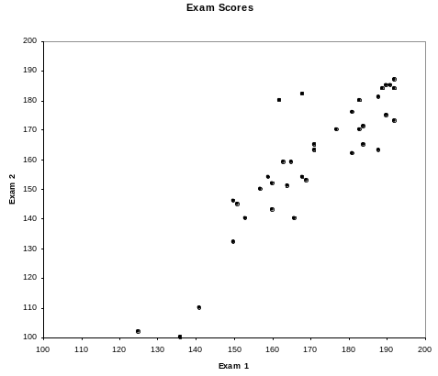
In class exercise #17:
Use “Insert” > “Chart” > “XY Scatter” to make a scatter plot of the exam scores at
www.stats202.com/exams_and_names.csv
Put Exam 1 on the X axis and Exam 2 on the Y axis.
Answer:

Slide 16
In class exercise #18:
The data www.stats202.com/more_stats202_logs.txt
contains access logs from May 7, 2007 to July 1, 2007.
Use “Data” > “PivotTable and PivotChart Report” In Excel to make a table with the counts of
GET /lecture2=start-chapter-2.ppt HTTP/1.1
and
GET /lecture2=start-chapter-2.pdf HTTP/1.1
for each date. Which is more popular?

Slide 17
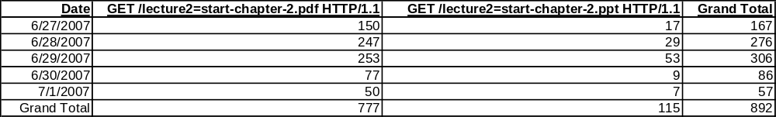
In class exercise #18:
The data www.stats202.com/more_stats202_logs.txt
contains access logs from May 7, 2007 to July 1, 2007.
Use “Data” > “PivotTable and PivotChart Report” In Excel to make a table with the counts of
GET /lecture2=start-chapter-2.ppt HTTP/1.1
and
GET /lecture2=start-chapter-2.pdf HTTP/1.1
for each date. Which is more popular?
Answer:

Slide 18
In class exercise #19:
The data www.stats202.com/more_stats202_logs.txt
contains access logs from May 7, 2007 to May 31, 2007.
Use “Data” > “PivotTable and PivotChart Report” In Excel to make a table with the counts of the rows for each date in May.

Slide 19
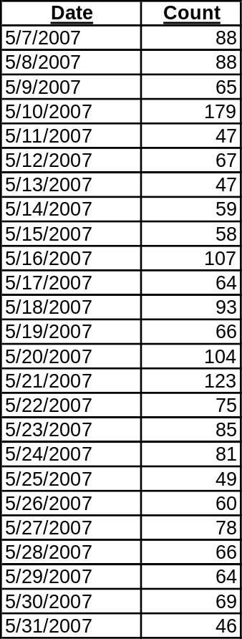
In class exercise #19:
The data www.stats202.com/more_stats202_logs.txt
contains access logs from May 7, 2007 to May 31, 2007.
Use “Data” > “PivotTable and PivotChart Report” In Excel to make a table with the counts of the rows for each date in May.
Answer:

Slide 20
In class exercise #20:
Use “Insert” > “Chart” > “Line” In Excel to make a graph on the number of rows versus the date for the previous exercise.

Slide 21
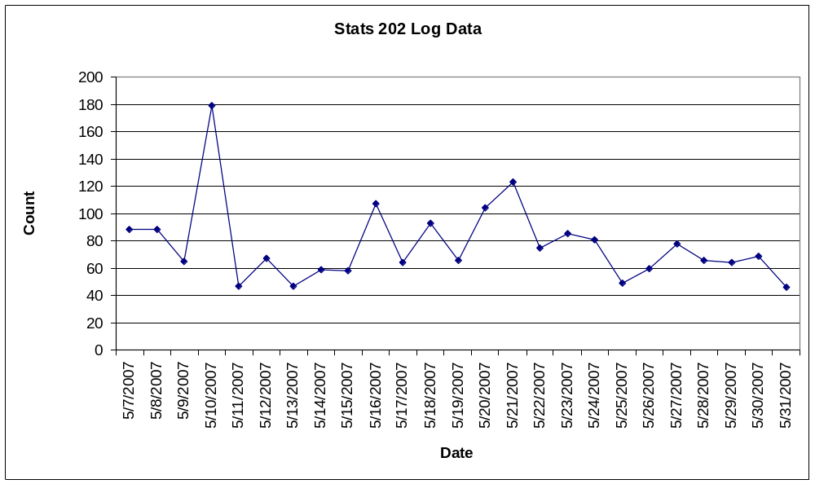
In class exercise #20:
Use “Insert” > “Chart” > “Line” In Excel to make a graph on the number of rows versus the date for the previous exercise.
Answer:

Slide 22
Using Color in Plots
In R, the graphing parameter “col” can often be used to specify different colors for points, lines etc.
Some advantages of color:
- provides a nice way to differentiate
- makes it more interesting to look at
Some disadvantages of color:
    - Some people are color blind
    - Most printing is in black and white
    - Color can be distracting
    - A poor color scheme can make the graph difficult to read (example: yellow lines in Excel)

Slide 23
3-Dimesional Plots
3D plots can sometimes be useful
One example is the 3D scatter plot for plotting 3 attributes (page 119)
The function scatterplot3d() makes fairly nice 3D scatter plots in R
-this is not in the base package so you need to do:
install.packages("scatterplot3d")
library(scatterplot3d)
However, it may be better to show the 3rd dimension by simply using a 2D plot with different plotting characters (page 119)

Slide 24
3-Dimesional Plots
Never use the 3rd dimension in a manner that conveys no extra information just to make the plot look more impressive

Slide 25
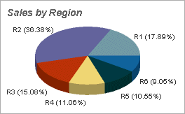
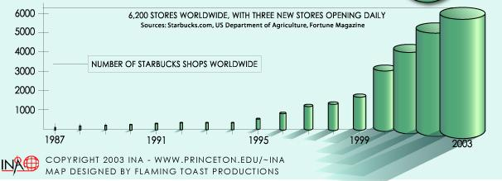
3-Dimesional Plots
Never use the 3rd dimension in a manner that conveys no extra information just to make the plot look more impressive
Examples:

Slide 26
In class exercise #21:
Not only does the 3rd dimension fail to provide any information in the previous two examples, but it can also distort the truth. How?

Slide 27
Do’s and Don’ts (Page 130)
Read the ACCENT Principles
Read Tufte’s Guidelines

Slide 28
Compressing Vertical Axis
✓
Bad Presentation
Good Presentation
Quarterly Sales
Quarterly Sales
$
$
200
50
100
25
0
0
Q1
Q2
Q3
Q4
Q1
Q2
Q3
Q4

Slide 29
No Zero Point On Vertical Axis
✓
Good Presentations
Bad Presentation
$
Monthly Sales
45
Monthly Sales
42
$
45
39
36
42
39
0
J
F
M
A
M
J
or
36
$
J
F
M
A
M
J
60
40
Graphing the first six months of sales
20
0
J
F
M
M
J
A

Slide 30
No Relative Basis
Bad Presentation
✓
Good Presentation
A’s received by students.
A’s received by students.
Freq.
%
300
30%
200
20%
100
10%
0
0%
FR
SO
JR
SR
FR
SO
JR
SR
FR = Freshmen, SO = Sophomore, JR = Junior, SR = Senior

Slide 31

Chart Junk
✓
Bad Presentation
Good Presentation
Minimum Wage
Minimum Wage
$
1960: $1.00
4
1970: $1.60
2
1980: $3.10
0
1960
1970
1980
1990
1990: $3.80

Slide 32
Final Touches
Many times plots are difficult to read or unattractive because people do not take the time to learn how to adjust default values for font size, font type, color schemes, margin size, plotting characters, etc.
In R, the function par() controls a lot of these
Also in R, the command expression() can produce subscripts and Greek letters in the text
-example: xlab=expression(alpha[1])
In Excel, it is often difficult to get exactly what you want, but you can usually improve upon the default values

Slide 33
Introduction to Data Mining
by
Tan, Steinbach, Kumar
Chapter 3: Exploring Data

Slide 34

Exploring Data
We can explore data visually (using tables or graphs) or numerically (using summary statistics)
Section 3.2 deals with summary statistics
Section 3.3 deals with visualization
We will begin with visualization
Note that many of the techniques you use to explore data are also useful for presenting data

Slide 35
Summary Statistics (Section 3.2, Page 98):
You should be familiar with the following elementary summary statistics:
-Measures of Location: Percentiles (page 100)
Mean (page 101)
Median (page 101)
-Measures of Spread: Range (page 102)
Variance (page 103)
Standard Deviation (page 103)
Interquartile Range (page 103)
-Measures of
Association: Covariance (page 104)
Correlation (page 104)

Slide 36
Measures of Location
Terminology: the “mean” is the average
Terminology: the “median” is the 50th percentile
Your book classifies only the mean and median as measures of location but not percentiles
More commonly, all three are thought of as measures of location and the mean and median are more specifically measures of center
Terminology: the 1st, 2nd and 3rd quartiles are the 25th, 50th and 75th percentiles respectively

Slide 37
Mean vs. Median
While both are measures of center, the median is sometimes preferred over the mean because it is more robust to outliers (=extreme observations) and skewness
If the data is right-skewed, the mean will be greater than the median
If the data is left-skewed, the mean will be smaller than the median
If the data is symmetric, the mean will be equal to the median

Slide 38


Slide 39
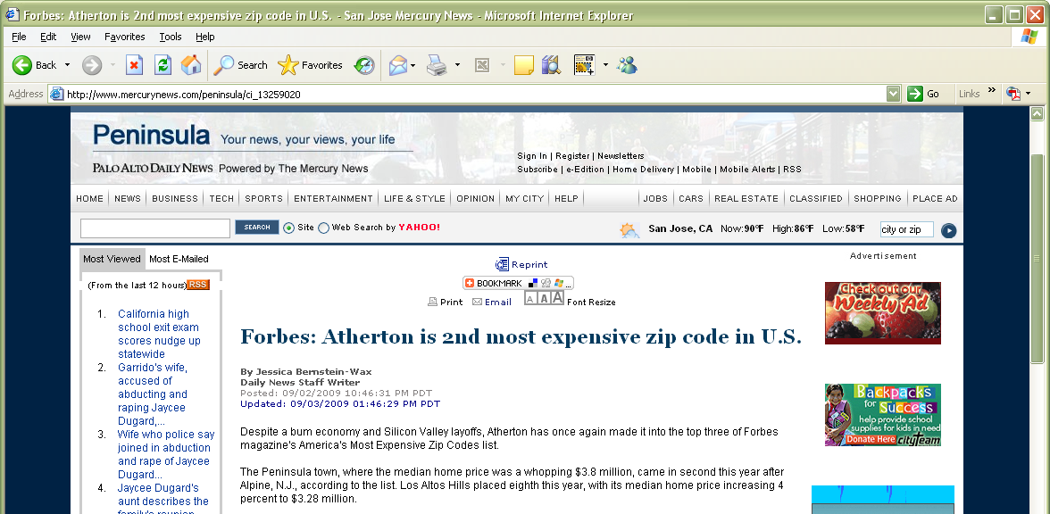

Slide 40
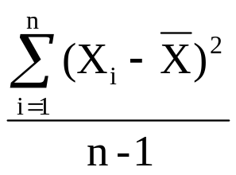

Measures of Spread:
The range is the maximum minus the minimum. This is not robust and is extremely sensitive to outliers.
The variance is
where n is the sample size and is the sample mean. This is also not very robust to outliers.
The standard deviation is simply the square root of the variance. It is on the scale of the original data. It is roughly the average distance from the mean.
The interquartile range is the 3rd quartile minus the 1st quartile. This is quite robust to outliers.

Slide 41
In class exercise #22:
Compute the standard deviation for this data by hand:
2 10 22 43 18
Confirm that R and Excel give the same values.

Slide 42
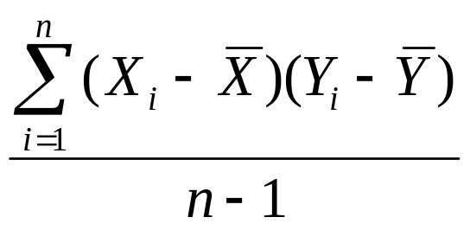

Measures of Association:
The covariance between x and y is defined as
where is the mean of x and is the mean of y and n is the sample size. This will be positive if x and y have a positive relationship and negative if they have a negative relationship.
The correlation is the covariance divided by the product of the two standard deviations. It will be between -1 and +1 inclusive. It is often denoted r. It is sometimes called the coefficient of correlation.
These are both very sensitive to outliers.

Slide 43
Correlation (r):
Y
Y
X
X
r = -1
r = -.6
Y
Y
X
X
r = +1
r = +.3

Slide 44
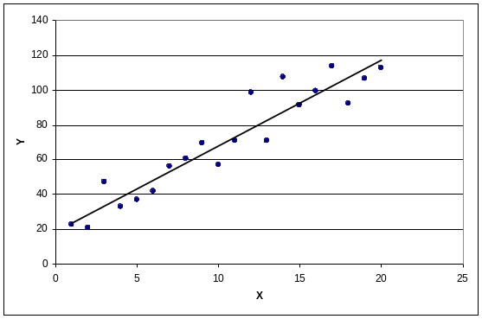
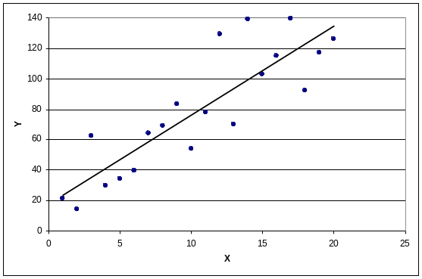
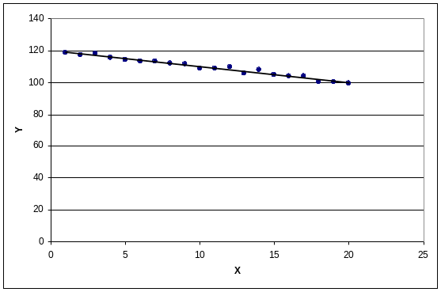
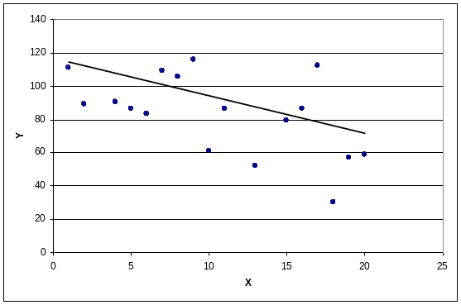
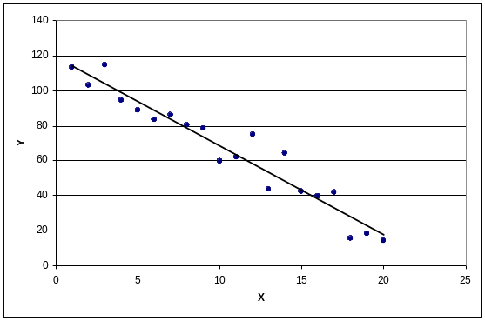
In class exercise #23:
Match each plot with its correct coefficient of correlation.
Choices: r=-3.20, r=-0.98, r=0.86, r=0.95,
r=1.20, r=-0.96, r=-0.40
A)
B)
C)
D)
E)

Slide 45
In class exercise #24:
Make two vectors of length 1,000,000 in R using
runif(1000000) and compute the coefficient of correlation using cor(). Does the resulting value surprise you?

Slide 46
In class exercise #25:
What value of r would you expect for the two exam scores in www.stats202.com/exams_and_names.csv
which are plotted below. Compute the value to check your intuition.

